Slide 1
Collaborative research with VHub Eyjafjallajökull ensemble modeling project
Simon A. Carn
VHub cyberinfrastructure for volcanology : Modeling, data sharing, and collaboration
IUGG
Earth on the Edge: Science for a Sustainable Planet
June 30 2011

Slide 2
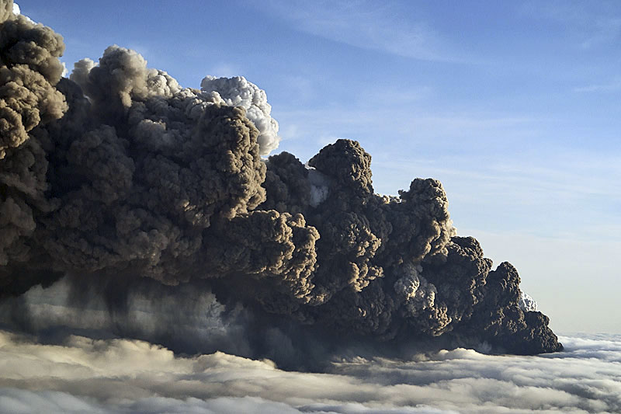
Eyjafjallajökull ensemble modeling
NSF-sponsored project (PI: Marcus Bursik, SUNY Buffalo)
Probabilistic modeling of the Eyjafjallajökull volcanic ash clouds
Team from SUNY Buffalo, Univ. Alaska Fairbanks, Michigan Tech, NOAA
Regular telecons
Used VHub to post/archive data, results (model runs), discussions, ideas, etc.

Slide 3
VHub groups

Slide 4
VHub groups – visibility and access
Notes:
Restricted – requires approval from group manager for membership
Open – anyone can join
Invite only
Private – only visible to group members
Visible – visible to all

Slide 5
VHub groups - overview

Slide 6
VHub groups - resources
Notes:
Members – list of group members.
Wiki – develop editable web pages, e.g., for display of graphical data
Resources – list of group resources (documents, PDFs, PPTs, offline tools, datasets etc.)
Discussion – discussions organized in threads
Messages – send/receive email to/from group members
Blog

Slide 7
VHub groups - advantages
Very useful for collaborative projects involving multiple institutions
Archive of entire project (documents, data, results, discussions) in one location
Ideal for collaboration using VHub simulation tools?
Notes:
Simon,
I found the VHub site very useful to keep all the information cataloged together. We were able to provide documents, upload data and papers so that all in the group could use it. I think the only negative is that it requires some learning to use the site. I might have not seen any document on this but for those who are no computer savvy might find it hard to navigate and assign tags.It was very useful with all of us in different institutions to be able collaborate and place our data in one location.
Cheers
Peter
Simon, Just got back from teaching field camp.
I thought vHub worked pretty well, especially as it has provided us aplace where we could keep tabs on the ideas, methodologies and datathat were discussed in telecon. I thought it was particularly usefulwhen you and Peter were putting up satellite and computational domaininformation, respectively, and when Matt was putting up results of thepuffin-puff runs. I don't think it could work well as a"stand-alone", but in connection with more immediate forms ofcommunication, it was ok, and I don't see that that will change. It'sfacilities are a bit clunky and outdated in comparison to the bestcommercial software. For example, a better image/PDF/PPT managementfacility would be helpful (along the line of facebook's), as well as amore direct link to and organizational structure for data and outputfiles (along the line of google docs), but allowing for things toappear to be files when they are just links to files on other systems-- but that is almost an IRODs issue probably. Another thing would bea better chat/rapid email type facility (like skype or gmail). Forexample, those here at UB were once involved in a lively exchange viaemail that died as soon as we tried to move it to vHub for archiving.Hope these comments are helpful and have a great time down under!
Marcus

Slide 8
VHub groups – improvements?
Better image/PDF/PPT management/online viewing?
Better chat/rapid email facility (like Skype)
Improved organizational structure for data and files (like Google Docs)
Include links to files on other systems (iRODS)
Notes:
Simon,
I found the VHub site very useful to keep all the information cataloged together. We were able to provide documents, upload data and papers so that all in the group could use it. I think the only negative is that it requires some learning to use the site. I might have not seen any document on this but for those who are no computer savvy might find it hard to navigate and assign tags.It was very useful with all of us in different institutions to be able collaborate and place our data in one location.
Cheers
Peter
Simon, Just got back from teaching field camp.
I thought vHub worked pretty well, especially as it has provided us aplace where we could keep tabs on the ideas, methodologies and datathat were discussed in telecon. I thought it was particularly usefulwhen you and Peter were putting up satellite and computational domaininformation, respectively, and when Matt was putting up results of thepuffin-puff runs. I don't think it could work well as a"stand-alone", but in connection with more immediate forms ofcommunication, it was ok, and I don't see that that will change. It'sfacilities are a bit clunky and outdated in comparison to the bestcommercial software. For example, a better image/PDF/PPT managementfacility would be helpful (along the line of facebook's), as well as amore direct link to and organizational structure for data and outputfiles (along the line of google docs), but allowing for things toappear to be files when they are just links to files on other systems-- but that is almost an IRODs issue probably. Another thing would bea better chat/rapid email type facility (like skype or gmail). Forexample, those here at UB were once involved in a lively exchange viaemail that died as soon as we tried to move it to vHub for archiving.Hope these comments are helpful and have a great time down under!
Marcus

