Slide 1
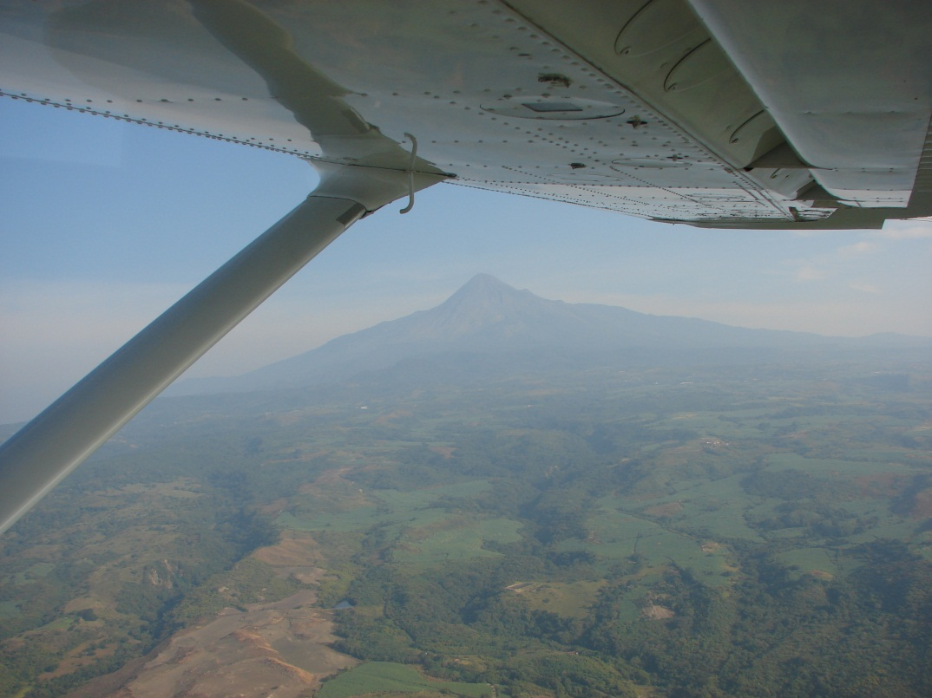
November 2014
VUELCO
Volcanic Unrest Simulation Exercises (VUSEX)
richard.bretton@bristol.ac.uk

Slide 2
UEA 2/41
18 March 2014
Housekeeping
The problem – Who, What, Why, Solution
Exercises – Past & Future
VUSEX – 10 Observations
Example

Slide 3
Supervisors at the University of Bristol Jo Gottsmann (School of Earth Sciences) Ryerson Christie (School of Sociology, Politics & International Studies) Funding VUELCO a project financed by the European Commission under the 7th Framework Programme for Research & Technological Development
UEA 2/41
18 March 2014

Slide 4
The problem
Who?
Hazard assessors (Volcano observatory staff)
Risk assessors & managers
Civil protection authorities
What ?
Many lack real time, actual, practical (as opposed to theoretical) experience of:
emerging periods of volcanic unrest
the many challenges that arise when the inevitable uncertainties of hazard characterisation meet societal & political demands for certainty.

Slide 5
The problem
Why?
Loss of traditional management capabilities which can sometimes be attributed to mobility & cultural de-rooting (WBGU 2000)
Timescales of volcanic eruptions do not correlate well with those of politics.
Whilst volcanoes may erupt very rarely, political terms tend to be around four years in length (Donovan & Oppenheimer 2012)

Slide 6
The problem
Solution?
The experience & levels of expertise of observing scientists are critical to making accurate forecasts & training is important (McGuire & Kilburn 1997)

Slide 7
The problem
For the things we have to learn before we can do them, we learn by doing them.
Aristotle, The Nicomachean Ethics
Practice doesn't make perfect. Practice reduces the imperfection.
Toba Beta, Master of Stupidity
We know that we will not always be as lucky.
Chris Newhall
The more I practice, the luckier I get.
Gary Player, Professional Golfer

Slide 8
Volcanic Unrest Simulation Exercises (VUSEX)
VUSEX must be differentiated from:
Volcanic Ash Exercises (VOLCEX) conducted regularly by:
Volcanic Ash Advisory Centres (VAACs),
International Civil Aviation Organisation (ICAO)
International Airways Volcano Watch (IAVW)
Eurocontrol
Civil Aviation authorities (CAA)
Air Navigation Service providers (ANSPs)
Airlines

Slide 9
VUSEX
VUSEX must be differentiated from:
Community Evacuation Exercises (CEVEX) conducted in many parts of the world
e.g. Indonesia, Philippines, Columbia, Ecuador, Mexico, Iceland

Slide 10
VUELCO
VUELCO has now carried out 2 out of 4 planned VUSE
November 2012 - Volcan de Colima, Mexico
February 2014 - Campi Flegrei, Italy
November 2014 - Cotopaxi, Ecuador
May 2015 - Morne aux Diables, Dominica
The meticulous planning of these complex exercises take many months & the exercises themselves involve a wide range of participants

Slide 11
When | Where | Volcano/Earthquake | Organisers | Length
2006 | Italy | Somma Vesuvius | DCP et al. | 6 days
2006 | New Zealand | Wellington | WDEM, MCDEM | 2 days
2007/8 | New Zealand | Auckland | ADEM, MCDEM | 4 months
2011 | USA | Yellowstone | USGS | 2 days
2012 | Mexico | Colima | VUELCO (1) | 4 days
2014 | Italy | Campi Flegrei | VUELCO (2) | 2 days
2014 | Tenerife, Spain | Teide | IGN et al. | 5 hours
2014 | Ecuador | Cotopaxi | VUELCO (3) | 2 days
2015 | Dominica | Morne aux Diables | VUELCO (4) | tba

Slide 12
VUELCO
VUSEX goals include the following:
to simulate, as realistically as possible, the evolution of "real past" & "future hypothetical" volcanic unrest crises
to analyse, within a practical setting, the volcanic risk governance regimes of its European & the Latin‐American participants
to assess & scrutinize the communication between scientists & civil protection authorities & between civil protection authorities, the media & the public

Slide 13
VUELCO
to explore the applicability of products (methods, models, procedures, protocols) developed within the VUELCO project
to identify VUSEX critical issues, strengths & weaknesses as well as possible improvements & how to achieve them
to set goals specific to the host volcano
to address the audit & training needs of local participants such as the CPA

Slide 14
VUSEX - Scope & Planning
VUELCO's goals are science-focussed & target the challenging & changing interfaces between:
hazard monitoring & hazard assessment
hazard assessment & risk assessment
related communication

Slide 15
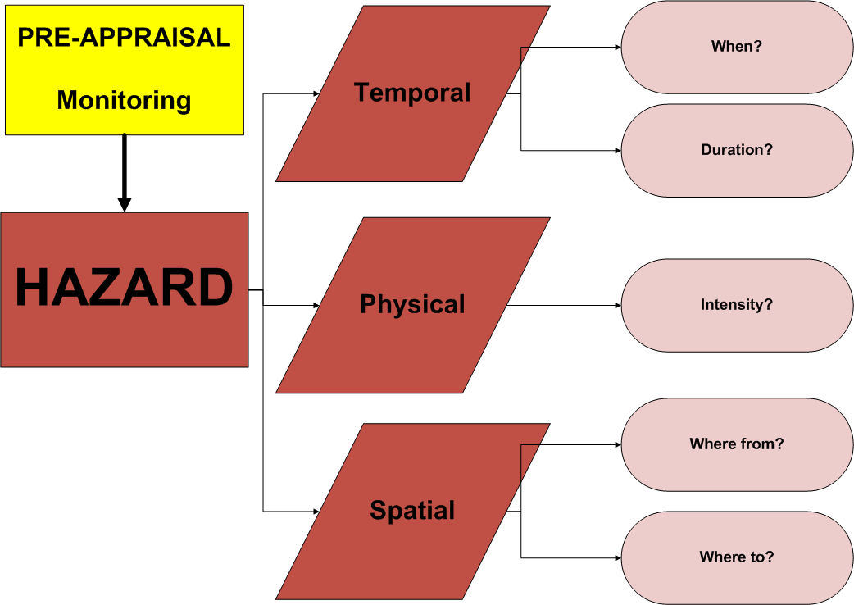

Slide 16
VUSEX - Scope & Planning
Long-term monitoring data
Pre-VUSEX carefully researched background paper summarising the past history & character of the host volcano (HV)
Pre-VUSEX HV Field trip
Main precursors of volcanic unrest at the HV
Short-term monitoring
Resources (equipment, employed staff, volunteers etc.)
Data output (nature, adequacy & timing)
Capacity to respond to changing demands

Slide 18
VUSEX - Scope & Planning
As the period of unrest evolves…real time…
Characterisations of:
possible & most likely hazard scenarios
their temporal, physical & spatial parameters
Other advice e.g. about merits/safety of further/different monitoring

Slide 19
VUSEX - Scope & Planning
Communications of:
Scientific analysis (with its inherent assumptions, limitations, complexities & uncertainties)
to a variety of stakeholders
each having different requirements & expectations

Slide 20
VUSEX – Main Issues
Stakeholders (VUSE Actors)
Reflect the HV's legal risk governance infrastructure
Include
Volcano (HV)
Local & external scientists (SAC)
Risk assessors & managers (CPA)
Plus ?
Volcano Observatory Scientists (VOS)
Media
Interested & affected parties
Maverick/minority scientists

Slide 21
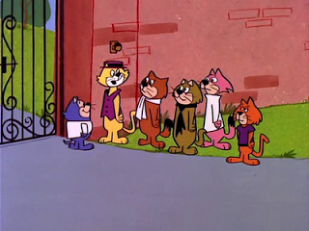
VUSEX – Main Issues
The roles of Stakeholders (VUSE Actors)
Reflect the HV's legal risk governance infrastructure
Roles include
Monitoring (the Volcano team)
Primary assessment of monitoring data
Hazard assessment
Volcano status levels
Risk assessment (options need & possibilities)
Risk management (options selection)
Civil protection (options implementation)
Risk status levels
Other (? Risk mitigation) status levels

Slide 22
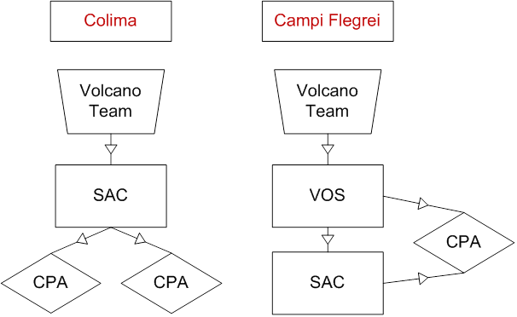

Slide 23
10 Observations
Based upon:
Reviews of:
2 VUSEX
Vesuvius, Yellowstone
2 Earthquake EX
Wellington & Auckland
Several VOLEX
Initial audits of:
2 VUELCO VUSEX
Colima, Campi Flegrei
Macaronesian VUSEX
Teide

Slide 24
VUSEX - 10 Observations
1. VUSEX should:
NOT attempt to replicate all aspects & phases of a risk governance regime
be focussed, purpose-driven & planned accordingly
Much of the value will be derived from the planning stage and by having clearly defined objectives for all participants
Scenario writing, briefing notes & diagrams, pre- exercise field trip/s
VUELCO's goals are science-focussed & target the challenging & changing interfaces between:
hazard monitoring & hazard assessment
hazard assessment & risk assessment
related communication

Slide 25
VUSEX - 10 Observations
2. VUSEX enable detailed consideration of the infrastructures, stakeholders and legal duties of risk governance
Participants should be the main stakeholders of hazard assessment, risk assessment & management civil protection etc.
Test:
All reporting & communicating relationships

Slide 26
VUSEX - 10 Observations
3. Scientific Advisory Committees (SAC)
Test:
Status
Role
Chairmanship
Composition, size, range of scientific disciplines
Linguistic/cultural difficulties
Processes, deliberation
Records
Insurance/Indemnities
Dealing with:
range of views
mavericks (inside & outside)
Communication to & from

Slide 27
VUSEX - 10 Observations
4. VUSEX provide a unique opportunity to test, in real time conditions/constraints, short-term monitoring data
Test:
Timing of provision
Range
Format (particularly for use of modelling tools)
Inadequacies
Capacity to respond to dynamic change during periods of escalating unrest

Slide 28
VUSEX - 10 Observations
5. VUSEX provide a unique opportunity to test, in real time conditions/constraints, prototype tools and structures
BET-EF (Bayesian Event Tree for Eruption Forecasting)
VOLCANBOX
QVAST
VORIS 2
HASSET
VOLCADAM
BADEMO
PLINIUS (Volcanic Impact Simulation model)
EMERNET (Software used in Teide VUSEX)
VOLCEX have tested:
New governance structures EACCC
New tools EVITA

Slide 29
VUSEX - 10 Observations
6. VUSEX provide a unique opportunity to test, in real time conditions/constraints, formal expert elicitation procedures
Test:
Structured discussion
Identifying possible & probable scenarios
Drafting of questions
Voting
Results
analysis
communication

Slide 30
VUSEX - 10 Observations
7. Hazard Assessment - Characterisation Outputs
Test:
Timings
Format
Source (how many, who, training?)
Content
Jargon (lahar) & scientific terms uncertainty/probabilistic terms
Use of numbers (65%)
Disagreement ranges (65-80%)
Value/ qualitative expressions (high, low, likely, possible)
Graphics

Slide 31
VUSEX - 10 Observations
8. Hazard Assessment - Advice
Test advice regarding:
Monitoring
Additional/different
Safety
Hazard/Volcano status levels
Secondary hazards – (Fires, aquifers, etc.)
Medium/long term evolution
Mitigation options
Hazard
Risk

Slide 32
VUSEX - 10 Observations
9. VUSEX are "Exercises in Communication"
Between:
Expert – Expert
Expert – Non-expert
Local - Visiting
Scientists – Non-scientists
Hazard communities – Risk communities
Assessment – Management – Managed (At-Risk)- Media
About:
Who
What – Content
What - Format
When
Why
Use:
Technology
Protocols etc.

Slide 33
VUSEX - 10 Observations
10. VUSEX will identify Imperfections to be assessed & addressed
Get "hot" and "cold" feedback from all participants
Identify:
Problems
Infrastructure
Stakeholders
Reporting
Communication (different requirements/expectations of recipients)
Needs
Information & Training
Checklists, guidance notes
Resources (people, equipment etc.)
Future VUSEX
Practice that worked
Benefits

Slide 34
SAC Report
The [SAC] based on the [VOS] report and videoconference confirms that the dynamics of the unrest are rapidly changing. Based on available data there are new indications (presence of SO2, shallow and laterally migrating LP seismicity) for the involvement of magma at shallow depth (2-3 km). At the same time some of the detected signals indicate that the shallow hydrothermal system is highly perturbed.
Based also on the historical record available we cannot exclude the occurrence of a rapid evolution of the current dynamics toward eruptive phenomena over timescales of days/months. Based on available data those phenomena could include phreatic explosions and small volume magmatic eruptions. At present the area most likely to be affected by eventual eruptive phenomena appears to be the eastern sector of the caldera.
Therefore, consideration should be given for revising the current state of alert.

Slide 35
The [SAC] based on the [VOS] report and videoconference confirms that the dynamics of the unrest are rapidly changing. Based on available data there are new indications (presence of SO2, shallow and laterally migrating LP seismicity) for the involvement of magma at shallow depth (2-3 km). At the same time some of the detected signals indicate that the shallow hydrothermal system is highly perturbed.
Based also on the historical record available we cannot exclude the occurrence of a rapid evolution of the current dynamics toward eruptive phenomena over timescales of days/months. Based on available data those phenomena could include phreatic explosions and small volume magmatic eruptions. At present the area most likely to be affected by eventual eruptive phenomena appears to be the eastern sector of the caldera.
Therefore, consideration should be given for revising the current state of alert.
[No time or date/forecast period/advice or statement re monitoring]

Slide 36
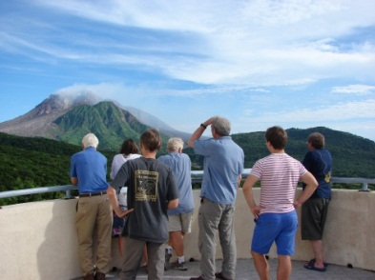
Questions

